Slide 1
TWITTER SENTIMENT ANALYSIS
TEAM MEMBERS:
NIKHIL JAGLAN (SID 18103118)
VAIBHAV PANDEY (SID 18103072)

Slide 2
Introduction
In this project we have analyzed the sentiments of the general public regarding the current political scenario of the country with the help of the tweets made by them.
We have used Twitter Application Programming Interface (API) to stream real-time tweets into our MySQL Database.
Analysis of real-time data and a robust Deep Learning model are the highlights of our project.

Slide 3
REQUIREMENTS
Twitter Developers Account
Twitter Application
MySQL Database
Training-Testing Data For Deep Learning Model
Programming Language used : Python

Slide 4
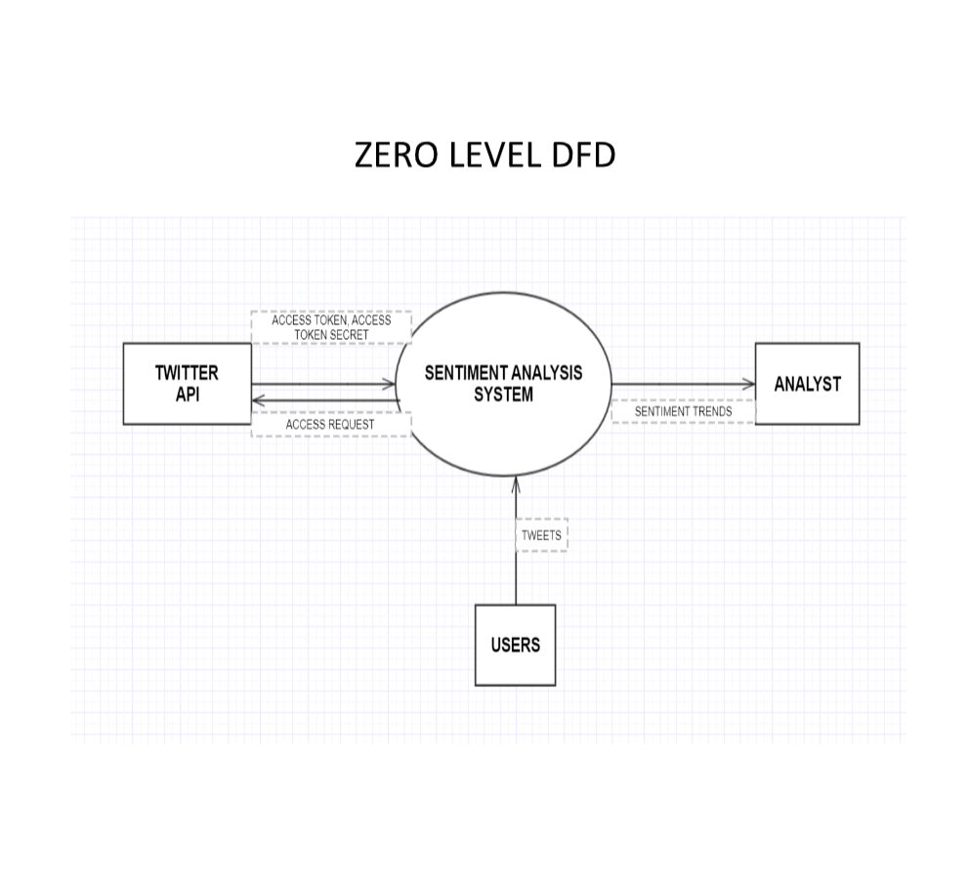
ZERO LEVEL DFD

Slide 5
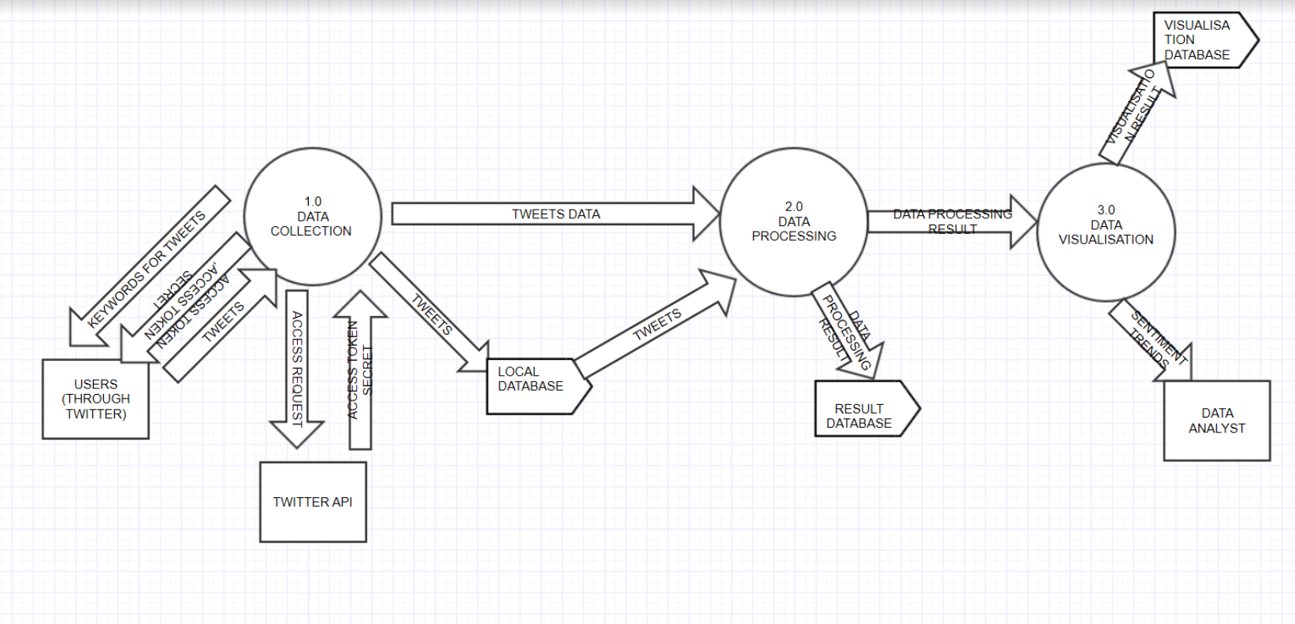
LEVEL 1 DFD
TRAIN-TEAST DATABASE
TRAIN-TEST DATA

Slide 6
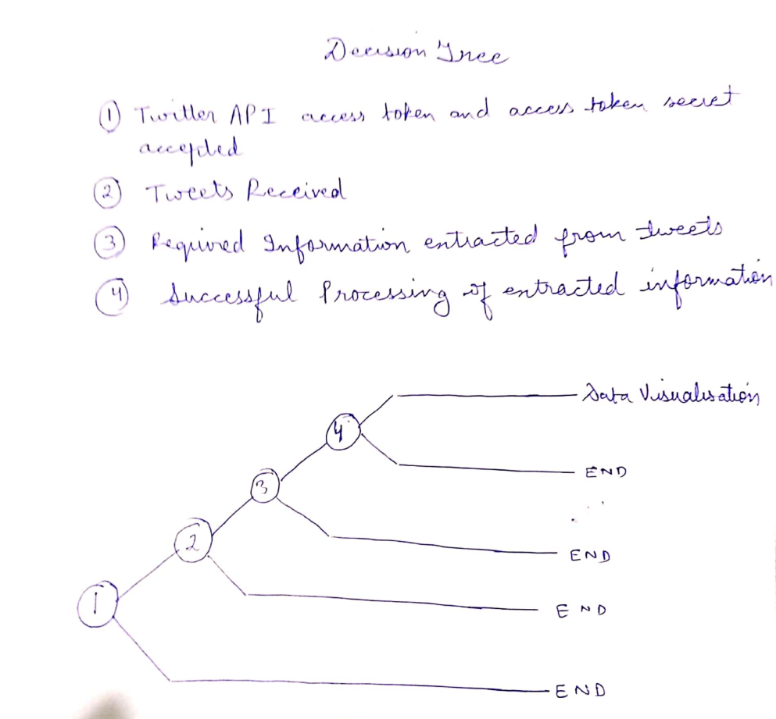
DECISION TREE

Slide 7
Data dictionary Level 0:
Process: Twitter Sentiment analysis System.
Description: Real-time tweets are extracted through twitter API and are stored in a MySQL database. Thereafter processing and classification of tweets is carried out. The trends thus obtained are sent/outputted to the analyst(system user) for any future analysis.

Slide 8
Input : Tweets
Access token
Access token secret
Output : Sentiment trends
Entities: User of twitter, analyst, twitter

Slide 9
Data Flow Name: Twitter Application Connection
Description: We request for API Connection by providing all required credentials.
To Process: Twitter API
From Process: Sentiment analysis system
Data structure: access token and access token secret

Slide 10
Data Flow Name : Tweets extraction and storage
Description: Extracting the relevant tweets and storing it in our databse.
To Process: Users
From Process: Sentiment analysis system
Data structure: Tweets

Slide 11
Data Flow Name: Sentiment trends to analyst
Description: Doing data processing and visualization
To Process: Analyst
From Process: Sentiment analysis system
Data structure: Processing result

Slide 12
Level 1.0 :
Process_1: Data Collection System
Description_1: This acquires the tweets of people from the twitter database with the help of access token and access token secret given.
Input: Keywords for Tweets extraction
Access token and Access token secret
Output: Tweets Data
Local database

Slide 13
Datastore: Local database is used
Item fields:
1. Access token : alphanumeric string
2. Access token secret : alphanumeric string
3.Tweets : Type String . Contains the tweets/text tweeted by people

Slide 14
Data Flow Name: Twitter API Connection
Description: Connecting with the twitter API by providing the access toktn and access token secret.
To Process: Twitter API
From Process : Sentiment Analysis System
Data Structure: Access Token and access token secret

Slide 15
Data Flow Name: Tweets Collection
Description: Acquiring the tweets
To Process: Users
Data structure: Tweets

Slide 16
Data Flow Name: database filling
Description: Tweets movement to database
To Process: Local database
From Process: Tweets Collection
Data Structure: Tweets

Slide 17
Level 1.2 :
Process_2: Data Processing System
Description_2:This is related to the processing of data and finding the optimal hyper-parameters. We finally train our model on the learnt parameters.
Input_2: Tweets Data
Local Database
Output_2: Data processing result
Item fields:
1.Result : Type tuple . Contains the sentiment's degree.

Slide 18
Data Flow Name: Tweets from database
Description: Getting the tweets from database
To Process: Data Processing
From Process: Local Database
Data structure: tweets

Slide 19
Data Flow Name: data processing
Description: processing of the acquired tweets
To process: result storage
From process: Local Database

Slide 20
Data Flow Name: Result storage
Description: Storing the results of sentiment analysis
To Process: Data Visualization
From Process: Data Processing

Slide 21
Level 1.3 :
Process_3: Data visualization
Description_3:Here we try to visualize our results, accuracy and the loss function
Input_3:Data processing result
Output_3: Sentiment trends visualization

Slide 22
Logic Summary : Here we visualize the sentiment trends obtained for proper analysis of trends obtained.
Datastore: Visualization database is used
Item fields:
Result : Type graph . Contains the data visualization graphs

Slide 23
Data Flow Name: Visualization result
Description: Visualization of trends obtained
From Process: Data Visualization
Data Structure: Graph

Slide 24
PROJRCT execution

Slide 25
Twitter api setup

Slide 26
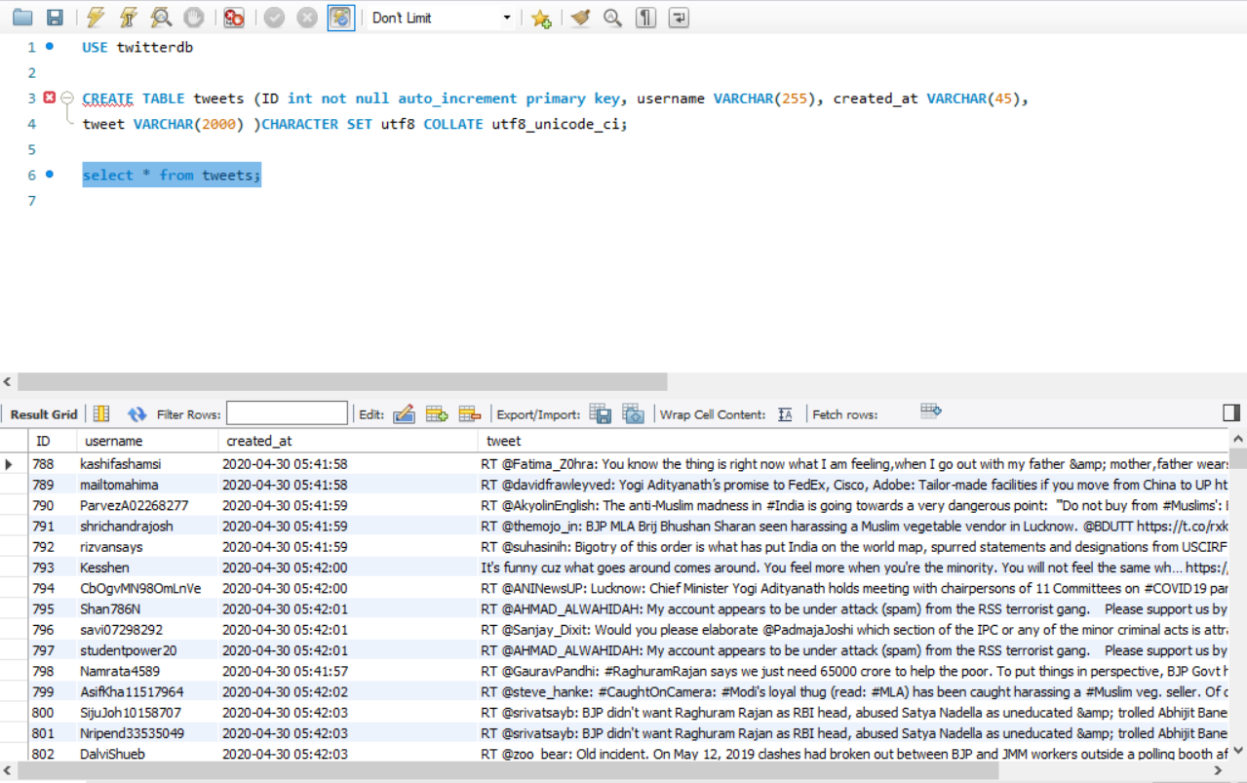
Mysql Database setup

Slide 27
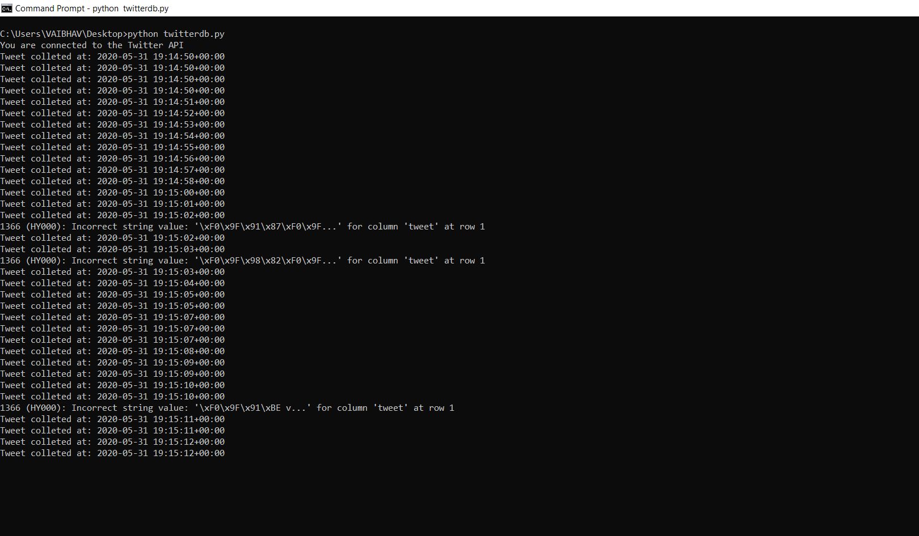
Tweets collection

Slide 28
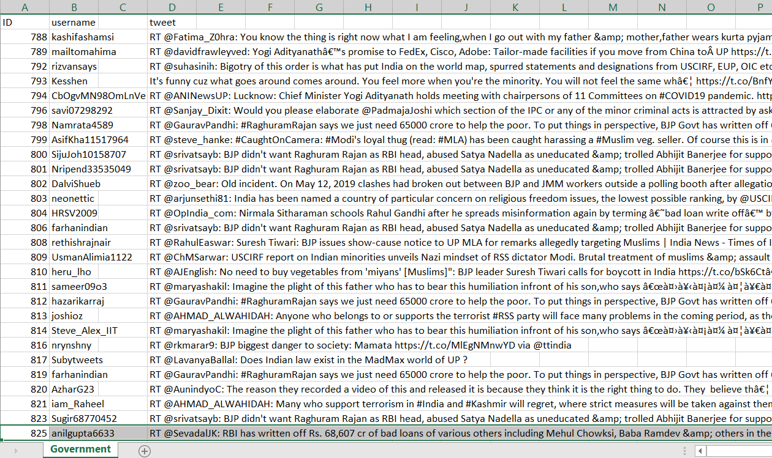
Csv file exported

Slide 29
Timeline of deep learning model
CHECKING IMBALANCE IN TRAINING DATASET
TEXT CLEANING
TRAIN – TEST SPLIT
WORD2VEC
TOKENISATION AND PADDING
BUILDING LSTM ARCHITECTURE
TRAINING AND VISUALISATION

Slide 30
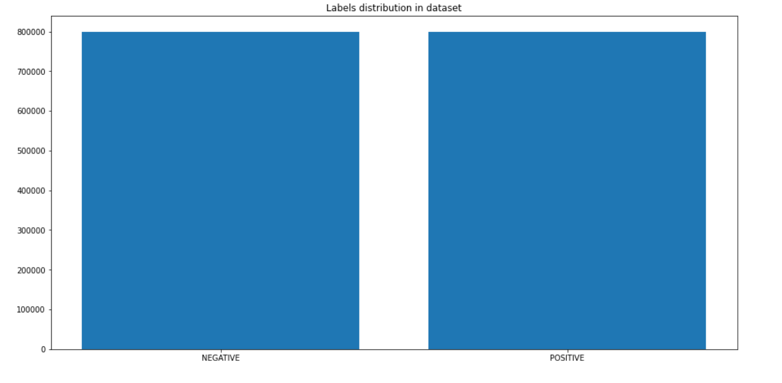
CHECKING IMBALANCE IN DATASET

Slide 31
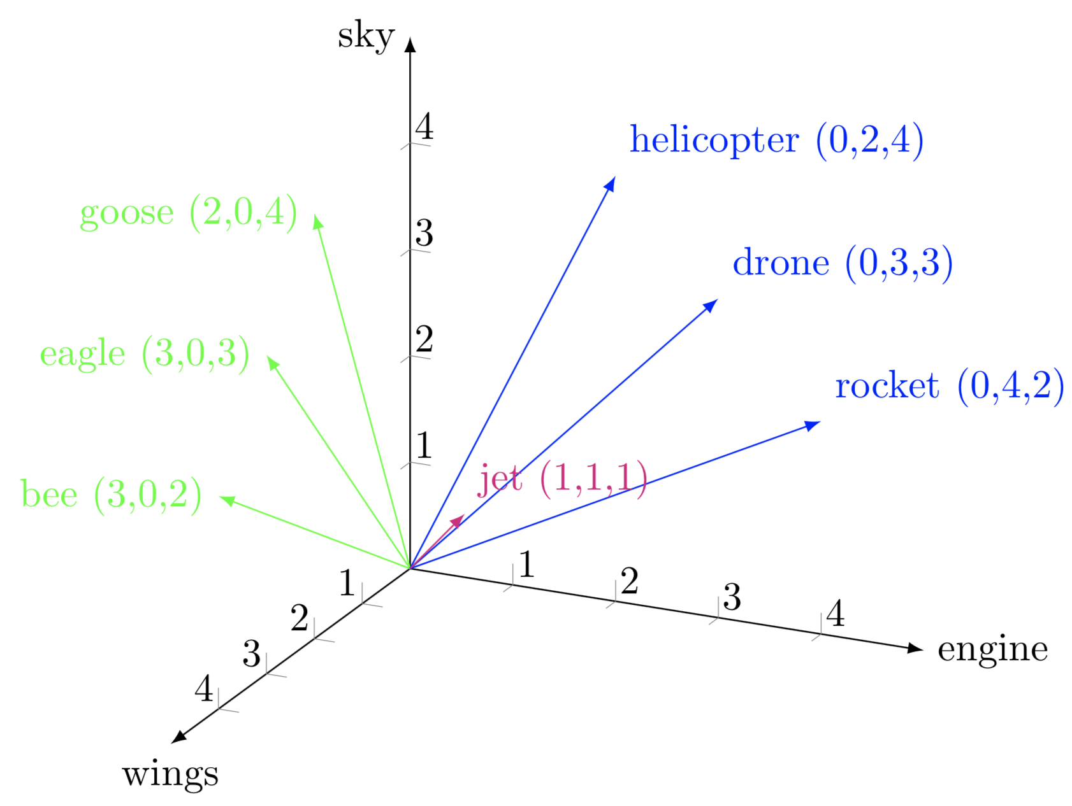
WORD2VEC

Slide 32
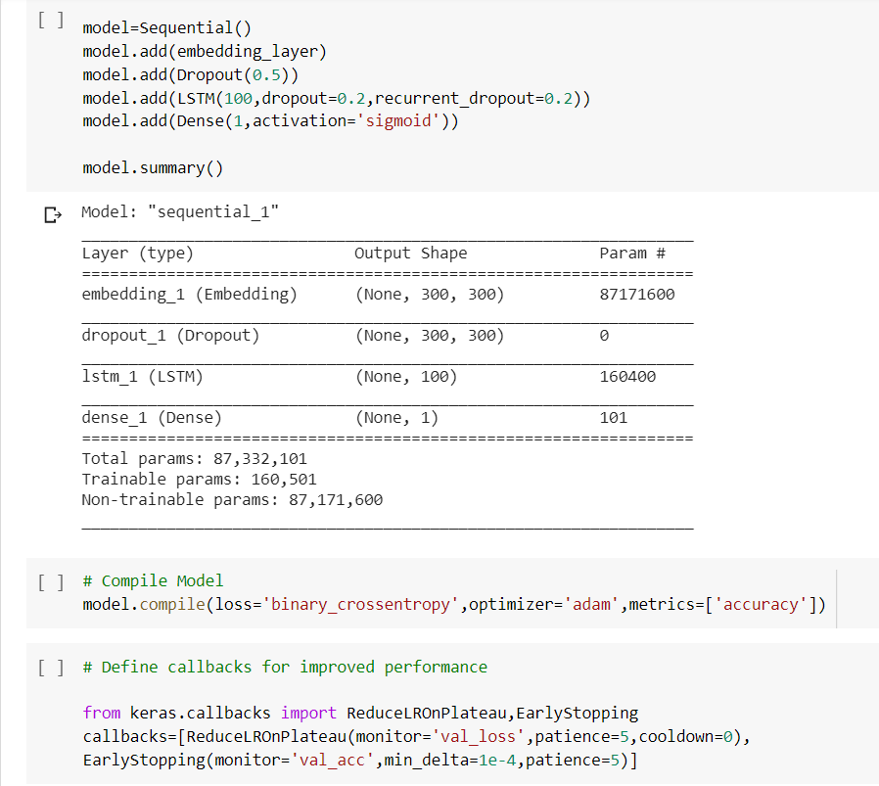
LSTM MODEL ARCHITECTURE

Slide 33
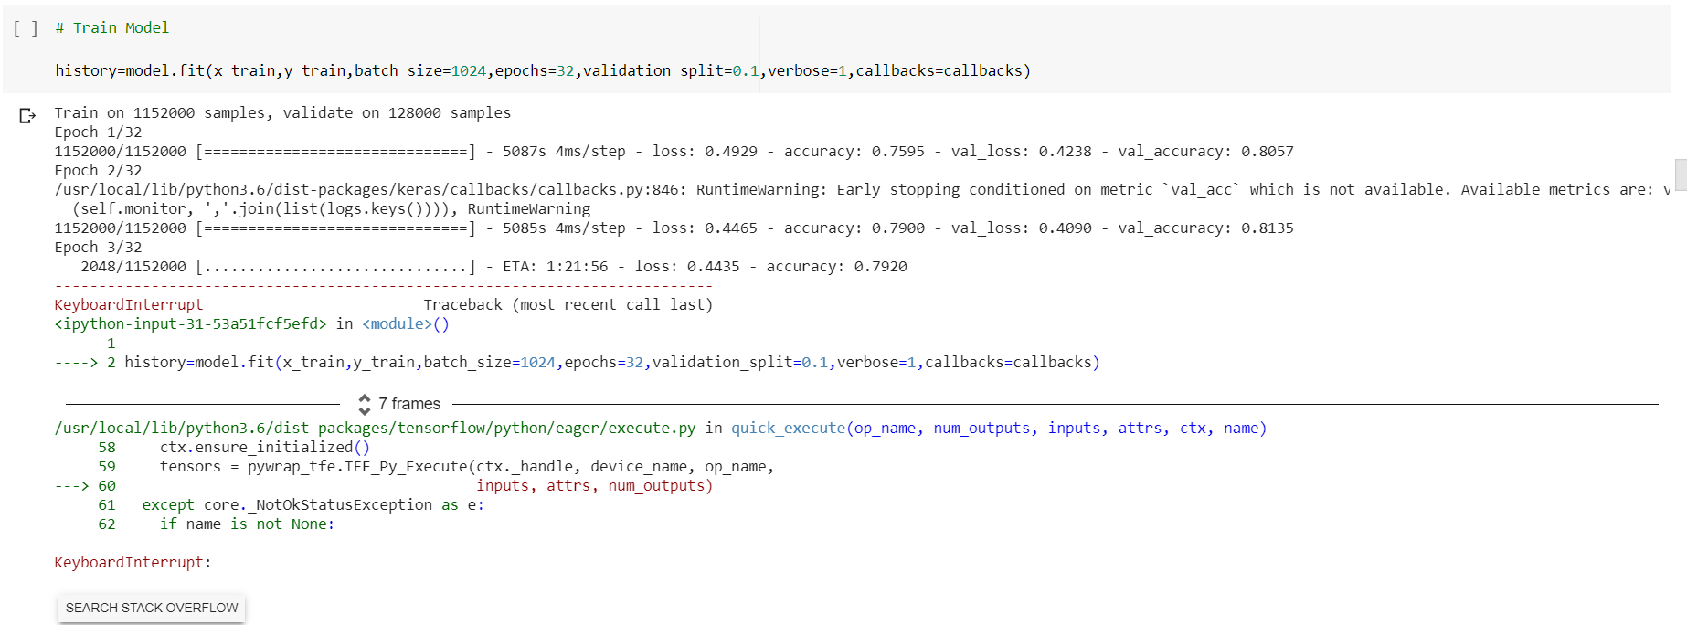
MODEL TRAINING

Slide 34
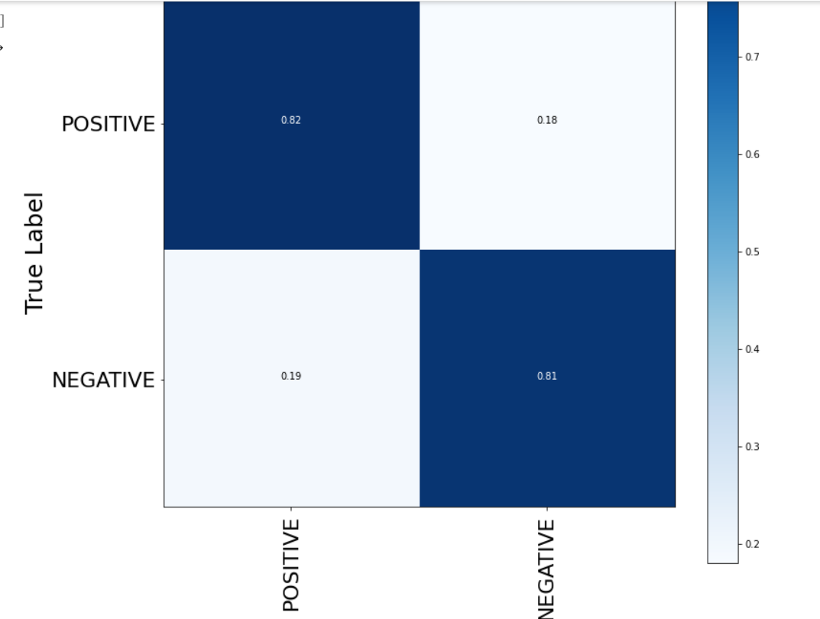
ACCURACY OF MODEL ON TEST DATASET

Slide 35
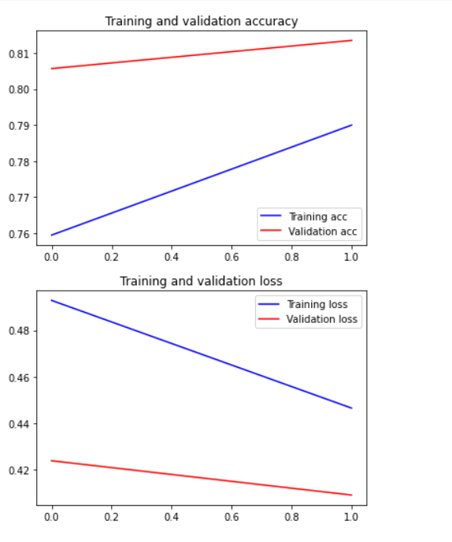
VISUALISATION OF ACCURACY AND LOSS

Slide 36
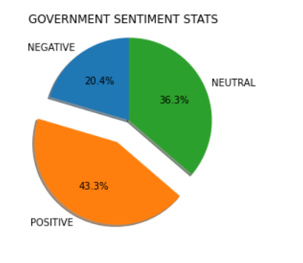
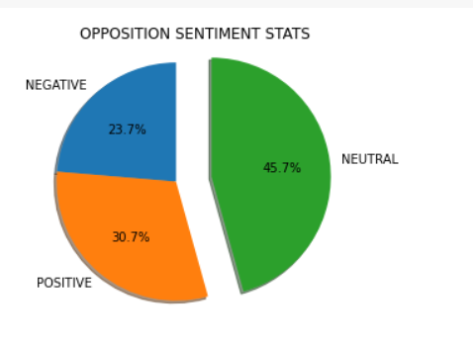
Visualization of sentiment trends

Slide 37
Conclusion
In current times, where data is considered the ‘new oil’ of the modern world, the goal is to transform data into information and information into insight. Data coupled with machine learning technology can help us achieve wonders. Machine learning has helped us conquer tasks which were considered impossible just until recent past and it is still evolving. We can expect an even deeper personalization of these machine learning models in the future which may even change our way of living itself and as Pearl Zhu, author of the “Digital Master” book series has rightly said, “We are moving slowly into an era where big data is the starting point, not the end. ”

Slide 38
thank you

